Slide 1





Design Patterns
VictorRentea.ro
victor.rentea@gmail.com
@victorrentea
© Copyright Victor Rentea 2017

Slide 2







Hi, I'm Victor Rentea
  Java Champion, enjoying since 2006
  Trainer – 5000+ developers of 100+ companies in 20+ countries
  Clean Code & Unit Testing
  Spring & JPA
  Architecture, DDD
  Java Performance
  Reactive Programming😱
  Secure Coding
  Speaker at Conferences & Meetups
  YouTube Channel
- in-house
- mixed groups
- video classes
Software Craftsmanship Community
Join at victorrentea.ro/community
and enjoy 1h/month of free workshop/talk
  VictorRentea.ro
  @victorrentea
Notes:
Salut! Eu sunt Victor si am 14 ani… de lucru cu Java, desi in ultimii ani am fost impins sa invat si PHP, Scala si C#.
Lucrez la IBM ca Lead Archirect, in Bucuresti. Stiati voi ca aveti un IBM chiar aici in Cluj, intr-un sediu nou-nout. In….
De fapt, cu ajorul IBM sunt astazi aici cu voi.
Stiu deja ce ganditi… aa.. E architect. Sta undeva langa un ficus si deseneaza pe pereti diagrame UML..
-NU . Eu bag la cod. Lucrez pe cele mai dificile proiecte pe care le avem.
La sfarsh:Sala mare -

Slide 3
Singleton
+other container lifecycles

Slide 4
new
Class A needs an instance of class X (therefore X has internal state)
What's wrong with new X(...)?
  Not polymorphic: unable to proxy X; unable to mock X while unit-testing A
  Creating X might grow complex: new X(new XA(new Foo(...)), new XB(...))
  Unable to control # of instances. Alternatives:
    pooling (=reuse for performance): DB Connection Pool, thread pool
    multi-ton (=1 instance / key): LoggerFactory.getLogger(...), 1 DataSource / tenant
    singleton
static methods
  X x = X.getInstance(); = the singleton idiom ➔ next slide
    Not polymorphic: no proxies, hard to mock
    Multi-threading + order of init = 😨
  ServiceLocator.getService(X.class) = a central registry managing instances ➔
DI framework ❤️ injecting in fields / constructor of A (eg: Spring, Guice, ..) ➔
  Easy to inject a Proxy or a Mock of X
  Singleton lifecycle ➔ stateless = ⚠️ fields should NOT keep user state in web APIs (for other scopes?)

Slide 5
Dependency Injection Rocks! 🤘
Takes care of lifecycle management for you
Less effort to break classes
Easier to decouple code in testing
Proxies can be transparently injected
Framework calls you = Inversion of Control (IoC)
  @GetMapping, @EventListener, @MessageListener, @Scheduled, ...
  The Hollywood principle: "Don't call us, we'll call you."

Slide 6


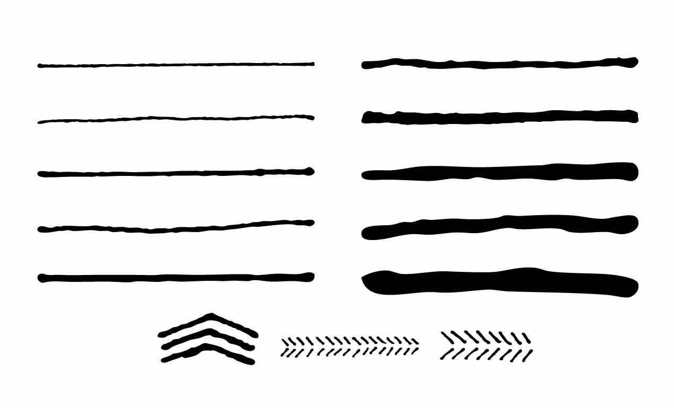
"Classic" Singleton
HOW?
Problems
  Idiomatic code
  Uncontrolled dependency in Prod
  Concurrent call of getInstance() 😱
  Difficult to decouple in Tests:
public class Singleton {
private static Singleton INSTANCE;
private Singleton() {
config = loadConfig(); /*300 ms*/
}
public static Singleton getInstance() {
if (INSTANCE == null) {
INSTANCE = new Singleton();
}
return INSTANCE;
}
private Config config;
...
}
mock
Mock Statics ☹
// production code:
Singleton s = Singleton.getInstance();
Config config = s.getConfig();
... logic to test using config ...
https://stackoverflow.com/questions/137975/what-is-so-bad-about-singletons

Slide 7

Dependency Injection
HOW?
@Service (Spring) or
@ApplicationScoped (javaEE)
public class A {
private final B b;
public A(B b) {
this.b = b;
}
...
}
The container takes care
to create only one instance
Obvious Dependencies
"Ask, and it will be given to you"
dependency
Container checks Wiring-up at Startup

Slide 8
Dealing with NULL
Passing null around = dangerous
Throw early for aberrant cases
  Requires global awareness
Return Optional<> to signal caller of absence
  Their job to handle it
Instantiate a Null Object
0 = business valid value
Data-Object: instance with default attributes
eg: MemberCard{fidelityPoints=0;email=null;}
Behavior-Object:
Null Object Pattern

Slide 9

Null Object Pattern
A
IA
NoopA
1) Extract Interface
2) Reimplement to do <nothing>
Examples: dummy authenticator, noop notifier, silent logger = side effecting object

Slide 10
Abstract Factory
Ensure max 1 instance gets created
Allow to construct types you don't know about
Construct test data
Instead of multiple overloaded constructors
Hide a constructor with too many arguments
Share data throughout your entire application
Changing an immutable object
Hide complex creation or dependencies
Avoid nulls
Life-cycle: dedicated instance per HTTP request
Factory Class
Factory Method
Object Mother
Fluent Builder
Singleton
Request Scoped
Optional
Null Object

Slide 11

Creational Patterns
Summary

Slide 12

Intercepting Calls
Wrap some code around existing methods
Decorator
Proxy
Aspect-Oriented Programming
Execute-Around (FP)

Slide 13

code(T t) {
..
}
Some code
expects an object of type T
class T {
m(..) {..}
}
Without editing the code of T,
how can I do more on T's methods?
code(new T());
class TGreen extends T {
@Override
m(..) {
..
super.m(..);
..
}
}
Using extends ➔
code(new TGreen());
Can I
"favor composition
over inheritance"?
But what if I want another variation (TSilent)?
(then TGreenSilent😨?)

Slide 14
code(T t) {
..
}
Some code
expects an object of type T
interface T {
m(..);
}
(T is an interface)
class TImpl
implements T{
m(..) {..}
}
Decorator Pattern
Another implementation of an interface wrapping around the original object
class TGreen //decorator
implements T {
private T delegate;
m(..) {
.. delegate.m(..);..
}
}
class TYellow //decoratr
implements T {
private T delegate;
m(..) {
.. delegate.m(..);..
}
}
(favor Composition over inheritance)
code(new TGreen(new TImpl()));
Alternative Wrappers ➔

Slide 15
Decorator Pattern
Another implementation of an interface wrapping around the original object
to execute code before/after/instead of the original method
«interface»
Subject
someMethod()
Writer
List
needs a
code(..)
actually calls
Decorator
delegate
someMethod()
BufferedWriter
UnmodifiableList
RealSubject
someMethod()
FileWriter
ArrayList
calls

Slide 16
copy-paste
copy-paste
D
R
Y
Don’t
Repeat
Yourself
<>
Write Everything Twice
We Enjoy Typing

Slide 17
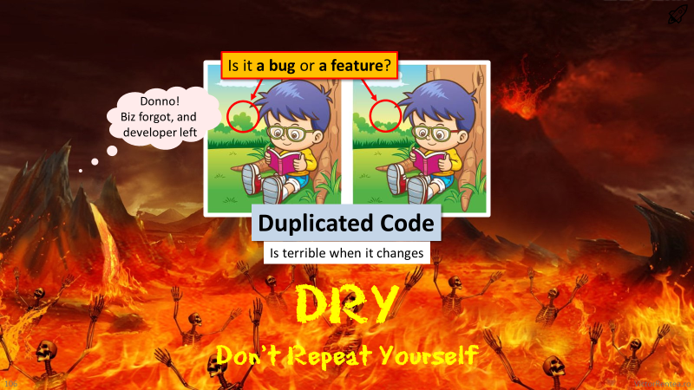

BTW, this is code copy-pasted 2 years ago
Find 5 differences !

Slide 18

Is it a bug or a feature?
Donno!
Biz forgot, and
the author left
Duplicated Code
becomes terrible when it changes
DRY Principle
Don't Repeat Yourself

Slide 19

In such dark moments, people turned to magic...

Slide 20


Aspect-Oriented Programming
Let's magically intercept
method calls...
to implement such
“Cross-cutting concerns”
(idiomatic code repeated in many places)
Logging
Transactions
Access Control... .. .. ...

Slide 21
Aspect-Oriented Programming
Idiomatic code:
start transaction
try {
<arbitrary code>
commit transaction
} catch (e) {
rollback transaction
}
Implement the same steps
(cross-cutting concerns)
"around" arbitrary code
without copy-paste
Java with Spring
@Transactional
public void f() {
<arbitrary code>
}

Slide 22


Proxy
placeholder intermediating interactions with an object
  The caller is given a Proxy to intercept its method calls, to do:
  (1) Aspect Oriented Programming
  (2) Remote calls (RMI, Web Services, Feign clients, Spring Data)
«interface»
Subject
someMethod()
needs a
The interface is NOT required today
by any proxying frameworks in Java
code(..)
actually calls
generated
by a framework
(CGLIB, Javaassist, ByteBuddy, AspectJ)
Proxy
someMethod()
Decorator
someMethod()
RealSubject
someMethod()
calls

Slide 23



Strategy
  alternative ways of doing a task implement the same interface
  eg: sorting, heuristics, handling a message, sending a notification, loading config...
Plugins (OCP)
Complex Logic
Contract of the task
«interface»
TaxCalculator
calculate(parcel):fee
code(TaxCalculator)
simple?
Functional
Programming
functions are
first-class citizens
EUTaxCalculator
calculate(parcel):fee
ChinaTaxCalculator
calculate(parcel):fee
Notes:
Omultetul este doar o clasa, codul care foloseste acest pattern, si nu un Actor UML

Slide 24
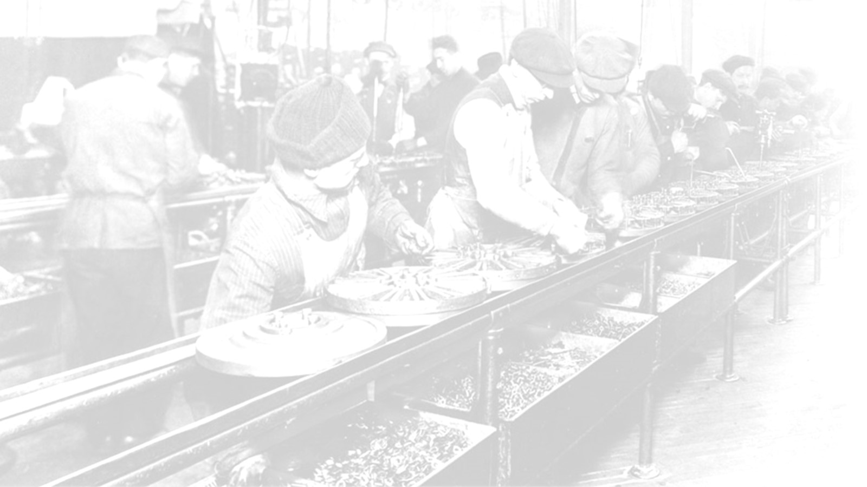




Chain of Responsibility
Decentralize
selection
complex
each filter can decide to process the request, or not
  Examples: Security Filters, HTTP Request/Response Filters on Client/Server, ...
Extremely Low Coupling
  A filter should not care who follows them
  Multiple filters can decide to act
  ☢ Order Matters
  if multiple filters can apply
  ➔ filters are usually listed in a config

Slide 25
Chain of Responsibility
Decentralize
selection
Implementation Forms
interface Filter {
boolean accepts(work);
Result process(work);
}
interface EventHandler {
// event.setCompleted(); when done
void handle(event);
}
interface ChainedFilter {
void doFilter(
request,
response,
next:Filter);
}
// next.doFilter(req,res)
interface OptionalFilter {
// return empty when not supported
Optional<Result> compute(request);
}
Others? ....

Slide 26

Recap
Large/Volatile Mapping
➔ externalize (eg. in a .yaml)
Risk of forgetting a case
➔ Functions on enums idiom 😝
➔ return switch (enum) idiom ✅
Strategy
Chain of Responsibility
switch
case
case
switch
for (filter:allFilters)
if (f.accepts(work))
f.process(work)
interface
➔ method
➔ class
filter1
{ accepts() process() }
➔ method
➔class
filter2
{ accepts() process() }
Any Logic
>2 lines
More Logic
>20+ lines
push complex selection inside, or
allow multiple filters to act

Slide 27

We want to checkout, please!
Room 763.
Facade
Sure thing!
I'll take care
of everything
for you, Sir!
Breakfast
Parking Fees
Room checkup
Minibar
Payment
Taxi

Slide 28


Facade
= unified interface over multiple components
1. Decouple Internals
By pulling the orchestration logic out
2. Decouple Clients
  Client convenience
  Freedom to refactor internals
Facade

